Slide 1


An Introduction to Linux
&

Slide 2
Credits
Cleveland Linux Users’ Group
  Introduction to Linux (Jeff Gilton & Jim Weirich)
IBM
  An Introduction to Linux (Al Henderson)
  Why Linux is storming the market (Jonathan Prial)
Ivan Bowman
  Conceptual software architecture of the Linux kernel

Slide 3
Contents
A quick guide to Linux
  Background
  Using Linux
  S/390 Specifics
Linux in the Marketplace
Commercial Linux Applications
Additional Resources

Slide 4
What is Linux
A fully-networked 32/64-Bit Unix-like Operating System
  Unix Tools Like sed, awk, and grep (explained later)
  Compilers Like C, C++, Fortran, Smalltalk, Ada
  Network Tools Like telnet, ftp, ping, traceroute
Multi-user, Multitasking, Multiprocessor
Has the X Windows GUI
Coexists with other Operating Systems
Runs on multiple platforms
Includes the Source Code

Slide 5
Where did it come from?
Linus Torvalds created it
  with assistance from programmers around the world
  first posted on Internet in 1991
Linux 1.0 in 1994; 2.2 in 1999
Today used on 7-10 million computers
  with 1000’s of programmers working to enhance it

Slide 6
Open Source Software
When programmers on the Internet can read, redistribute, and modify the source for a piece of software, it evolves
People improve it, people adapt it, people fix bugs. And this can happen at a speed that, compared to conventional software development, seems astonishing

Slide 7
How do you get it?
Download it from the Internet
From a “Distribution” (e.g. RedHat)
  Linux kernel
  X Windows system and GUI
  Web, e-mail, FTP servers
  Installation & configuration support
  3rd party apps
  Hardware support

Slide 8
Why is it significant?
Growing popularity
Powerful
  Runs on multiple hardware platforms
  Users like its speed and stability
  No requirement for latest hardware
It’s “free”
  Licensed under GPL
  Vendors are distributors who package Linux

Slide 9
Linux/390
Using it

Slide 10
Logging In
Connect to the Linux system using telnet:
  vt100, vt220, vt320
  ansi
  tty
  X-windows
Able to login more than once with same user
No ‘MW’ problems!

Slide 11
Logging In
Before you can use it you must login by specifying your account and password:
Linux 2.2.13 (penguinvm.princeton.edu) (ttyp1)
penguinvm login: neale
Password:
Last login: Tue Jan 4 10:13:13 from linuxtcp.princeton.edu
[neale@penguinvm neale]$

Slide 12
Rule Number 1
Do not login as root unless you have to
root is the system superuser (the “maint” of Linux but more “dangerous”)
  Normal protection mechanisms can be overridden
  Careless use can cause damage
  Has access to everything by default
root is the only user defined when you install
  First thing is to change root’s password
  The second job is to define “normal” users for everyday use

Slide 13
Creating a new user
Use the useradd command
Use the passwd command to set password
Try it… logon as root
[root@penguinvm]# useradd scully
[root@penguinvm]# passwd scully
Changing password for user scully
New UNIX password:
Retype new UNIX password:
passwd: all authentication tokens updated successfully
[root@penguinvm]#

Slide 14
Adding a new user
Limits on users can be controlled by
  Quotas
  ulimit command
Authority levels for a user controlled by group membership

Slide 15
Users and Groups
Users are identified by user identifications (UIDs), each of which is associated with an integer in the range of 0 to 4 294 967 295 (X’FFFFFFFF’). Users with UID=0 are given superuser privileges.
Users are placed in groups, identified by group identifications (GIDs). Each GID is associated with an integer in the range from 0 to 4 294 967 295
Let the system assign UID to avoid duplicates
Use id to display your user and group information
uid=500(neale) gid=500(neale) groups=500(neale),3(sys),4(adm)

Slide 16
Users and Groups
Groups define functional areas/responsibilities
They allow a collection of users to share files
A user can belong to multiple groups
You can see what groups you belong to using the groups command:
neale sys adm

Slide 17
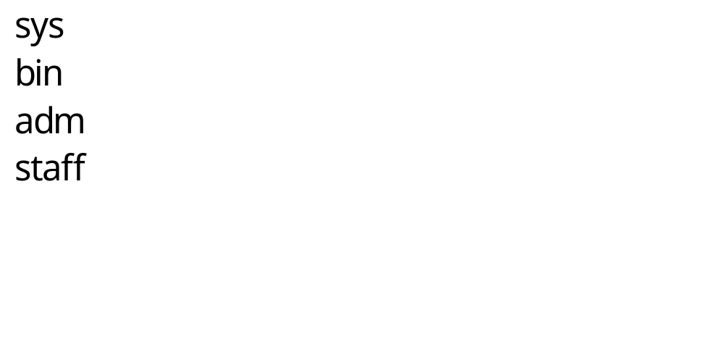
Typical Group Setup

Slide 18
Using the new user
Now logoff using the exit command
login as the new user
Linux 2.2.13 (penguinvm.princeton.edu) (ttyp2)
penguinvm login: scully
Password:
[scully@penguinvm scully]$

Slide 19
You need help?
The Linux equivalent of HELP is man (manual)
  Use man -k <keyword> to find all commands with that keyword
  Use man <command> to display help for that command
    Output is presented a page at a time. Use b for to scroll backward, f or a space to scroll forward and q to quit

Slide 20
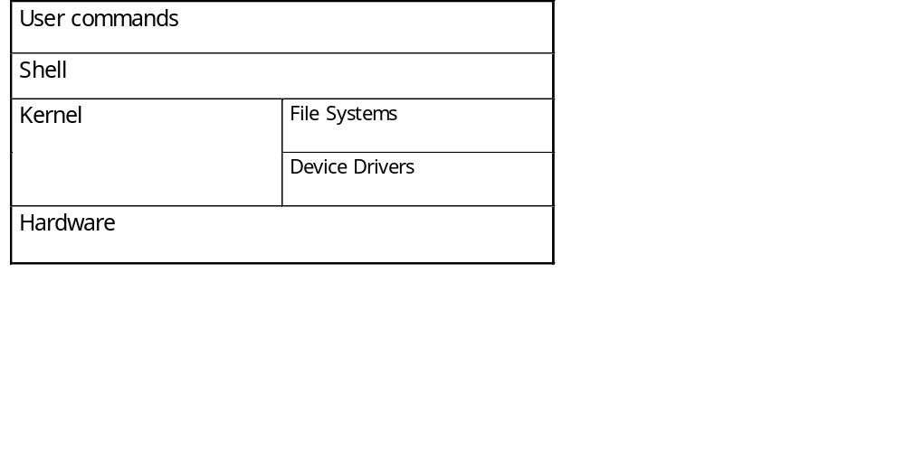
The Linux System
User commands includes executable programs and scripts
The shell interprets user commands. It is responsible for finding the commands and starting their execution. Several different shells are available. Bash is popular,
The kernel manages the hardware resources for the rest of the system.

Slide 21
Linux File System Basics
Linux files are stored in a single rooted, hierarchical file system
  Data files are stored in directories (folders)
  Directories may be nested as deep as needed
Directories
/
root
etc
home
usr
passwd
inittab
User home directories
neale
scully
marty
a
b
Data files

Slide 22
Naming Files
Files are named by
  naming each containing directory
  starting at the root
This is known as the pathname
/
etc
home
usr
passwd
inittab
/etc/passwd
neale
scully
marty
a
b
/home/neale/b

Slide 23
The Current Directory
One directory is designated the current working directory
  if you omit the leading / then path name is relative to the current working directory
  Use pwd to find out where you are
/
etc
home
usr
passwd
inittab
neale
scully
marty
Current working directory
a
doc
doc/letter
./doc/letter
/home/neale/doc/letter
letter

Slide 24
Some Special File Names
Some file names are special:
  / The root directory (not to be confused with the root user)
  . The current directory
  .. The parent (previous) directory
  ~ My home directory
Examples:
  ./a same as a
  ../jane/x go up one level then look in directory jane for x

Slide 25
Special Files
/home - all users’ home directories are stored here
/bin, /usr/bin - system commands
/sbin, /usr/sbin - commands used by sysadmins
/etc - all sorts of configuration files
/var - logs, spool directories etc.
/dev - device files
/proc - special system files

Slide 26
Linux Command Basics
To execute a command, type its name and arguments at the command line
ls -l /etc
Command name
Arguments
Options
(flags)

Slide 27
Standard Files
UNIX concept of “standard files”
  standard input (where a command gets its input) - default is the terminal
  standard output (where a command writes it output) - default is the terminal
  standard error (where a command writes error messages) - default is the terminal

Slide 28
Redirecting Output
The output of a command may be sent (piped) to a file:
ls -l >output
“>” is used to specify the output file

Slide 29
Redirecting Input
The input of a command may come (be piped) from a file:
wc <input
“<” is used to specify the input file

Slide 30
Connecting commands with Pipes
Not as powerful as CMS Pipes but the same principle
The output of one command can become the input of another:
Like CMS Pipes, “|” is used to separate stages
ps aux | grep netscape | wc -l
The output of the ps command is sent to grep
wc takes this input and counts the lines its output going to the console
grep takes input and searches for “netscape” passing these lines to wc

Slide 31
Command Options
Command options allow you to control a command to a certain degree
Conventions:
  Usually being with a single dash and are a single letter (“-l”)
  Sometimes have double dashes followed by a keyword (“--help”)
  Sometimes follow no pattern at all

Slide 32
Common Commands
pwd - print (display) the working directory
cd <dir> - change the current working directory to dir
ls - list the files in the current working directory
ls -l - list the files in the current working directory in long format

Slide 33
File Commands
cp <fromfile> <tofile>
  Copy from the <fromfile> to the <tofile>
mv <fromfile> <tofile>
  Move/rename the <fromfile> to the <tofile>
rm <file>
  Remove the file named <file>
mkdir <newdir>
  Make a new directory called <newdir>
rmdir <dir>
  Remove an (empty) directory

Slide 34
More Commands
who
  List who is currently logged on to the system
whoami
  Report what user you are logged on as
ps
  List your processes on the system
ps aux
  List all the processes on the system
echo “A string to be echoed”
  Echo a string (or list of arguments) to the terminal

Slide 35
More Commands
alias - used to tailor commands:
  alias erase=rm
  alias grep=”grep -i”
ar - Maintain archive libraries: a collection of files (usually object files which may be linked to a program, like a CMS TXTLIB)
ar -t libgdbm.a
__.SYMDEF
dbmopen.o

Slide 36
More Commands
awk - a file processing language that is well suited to data manipulation and retrieval of information from text files
chown - sets the user ID (UID) to owner for the files and directories named by pathname arguments. This command is useful when from test to production
chown -R apache:httpd /usr/local/apache

Slide 37
More Commands
diff - attempts to determine the minimal set of changes needed to convert a file specified by the first argument into the file specified by the second argument
find - Searches a given file hierarchy specified by path, finding files that match the criteria given by expression

Slide 38
More Commands
grep - Searches files for one or more pattern arguments. It does plain string, basic regular expression, and extended regular expression searching
find ./ -name "*.c" | xargs grep -i "fork"
In this example, we look for files with an extension “c” (that is, C source files). The filenames we
find are passed to the xargs command which takes these names and constructs a command line
of the form: grep -i fork <file.1>…<file.n>. This command will search the files for the
occurrence of the string “fork”. The “-i” flag makes the search case insensitve.

Slide 39
More Commands
kill - sends a signal to a process or process group
You can only kill your own processes unless you are root
UID PID PPID C STIME TTY TIME CMD
root 6715 6692 2 14:34 ttyp0 00:00:00 sleep 10h
root 6716 6692 0 14:34 ttyp0 00:00:00 ps -ef
[root@penguinvm log]# kill 6715
[1]+ Terminated sleep 10h

Slide 40
More Commands
make - helps you manage projects containing a set of interdependent files (e.g. a program with many source and object files; a document built from source files; macro files)
make keeps all such files up to date with one another: If one file changes, make updates all the other files that depend on the changed file
Roughly the equivalent of VMFBLD

Slide 41
More Commands
sed - applies a set of editing subcommands contained in a script to each argument input file
find ./ -name "*.c,v" | sed ’s/,v//g’ | xargs grep "PATH"
This finds all files in the current and subsequent directories with an extension of c,v. sed then strips the ,v off the results of the find command. xargs then uses the results of sed and builds a grep command which searches for occurrences of the word PATH in the C source files.

Slide 42
More Commands
tar - manipulates archives
  An archive is a single file that contains the complete contents of a set of other files; an archive preserves the directory hierarchy that contained the original files. Similary to a VMARC file
tar -tzf imap-4.7.tar.gz
imap-4.7/
imap-4.7/src/
imap-4.7/src/c-client/
imap-4.7/src/c-client/env.h
imap-4.7/src/c-client/fs.h

Slide 43
Shells
An interface between the Linux system and the user
Used to call commands and programs
An interpreter
Powerful programming language
  “Shell scripts” = .bat .cmd EXEC REXX
Many available (bsh; ksh; csh; bash; tcsh)

Slide 44
Another definition of a Shell
A shell is any program that takes input from the user, translates it into instructions that the operating system can understand, and conveys the operating system's output back to the user.
  i.e. Any User Interface
  Character Based v Graphics Based

Slide 45
Why Do I Care About The Shell?
Shell is Not Integral Part of OS
  UNIX Among First to Separate
  Compare to MS-DOS, Mac, Win95, VM/CMS
  GUI is NOT Required
  Default Shell Can Be Configured
    chsh -s /bin/bash
    /etc/passwd
  Helps To Customize Environment

Slide 46
Shell Scripts
#!/bin/bash
while
true
do
cat somefile > /dev/null
echo .
done
/* */
do forever
‘PIPE < SOME FILE | hole’
say ‘.’
end

Slide 47
Switching Users
su <accountname>
  switch user accounts. You will be prompted for a password. When this command completes, you will be logged into the new account. Type exit to return to the previous account
su
  Switch to the root user account. Do not do this lightly
Note: The root user does not need to enter a password when switching users. It may become any user desired. This is part of the power of the root account.

Slide 48
Environment Variables
Environment variables are global settings that control the function of the shell and other Linux programs. They are sometimes referred to global shell variables.
Setting:
  VAR=/home/fred/doc
  export TERM=ansi
  SYSTEMNAME=`uname -n`
Similar to GLOBALV SET … in CMS

Slide 49
Environment Variables
Using Environment Variables:
  echo $VAR
  cd $VAR
  cd $HOME
  echo “You are running on $SYSTEMNAME”
Displaying - use the following commands:
  set (displays local & env. Vars)
  export
Vars can be retrieved by a script or a program

Slide 50
Some Important Environment Variables
HOME
  Your home directory (often be abbreviated as “~”)
TERM
  The type of terminal you are running (for example vt100, xterm, and ansi)
PWD
  Current working directory
PATH
  List of directories to search for commands

Slide 51
PATH Environment Variable
Controls where commands are found
  PATH is a list of directory pathnames separated by colons. For example:
  PATH=/bin:/usr/bin:/usr/X11R6/bin:/usr/local/bin:/home/scully/bin
  If a command does not contain a slash, the shell tries finding the command in each directory in PATH. The first match is the command that will run

Slide 52
PATH Environment Variable
Similar to setting the CMS search order
Usually set in /etc/profile (like the SYSPROF EXEC)
Often modified in ~/.profile (like the PROFILE EXEC)

Slide 53
File Permissions
Every file
  Is owned by someone
  Belongs to a group
  Has certain access permissions for owner, group, and others
  Default permissions determined by umask

Slide 54
File Permissions
Every user:
  Has a uid (login name), gid (login group) and membership of a "groups" list:
    The uid is who you are (name and number)
    The gid is your initial “login group” you normally belong to
    The groups list is the file groups you can access via group permissions

Slide 55
File Permissions
Linux provides three kinds of permissions:
  Read - users with read permission may read the file or list the directory
  Write - users with write permission may write to the file or new files to the directory
  Execute - users with execute permission may execute the file or lookup a specific file within a directory

Slide 56
File Permissions
The long version of a file listing (ls -l) will display the file permissions:
-rwxrwxr-x 1 rvdheij rvdheij 5224 Dec 30 03:22 hello
-rw-rw-r-- 1 rvdheij rvdheij 221 Dec 30 03:59 hello.c
-rw-rw-r-- 1 rvdheij rvdheij 1514 Dec 30 03:59 hello.s
drwxrwxr-x 7 rvdheij rvdheij 1024 Dec 31 14:52 posixuft
Permissions
Group
Owner

Slide 57
Interpreting File Permissions
-rwxrwxrwx
Other permissions
Group permissions
Owner permissions
Directory flag (d=directory; l=link)

Slide 58
Changing File Permissions
Use the chmod command to change file permissions
  The permissions are encoded as an octal number
chmod 755 file # Owner=rwx Group=r-x Other=r-x
chmod 500 file2 # Owner=r-x Group=--- Other=---
chmod 644 file3 # Owner=rw- Group=r-- Other=r--
chmod +x file # Add execute permission to file for all
chmod o-r file # Remove read permission for others
chmod a+w file # Add write permission for everyone

Slide 59
Links?
Links are references to files (aliases)
Two forms:
  Hard
  Symbolic
    Can point to files on different physical devices
    Delete of original leaves link
    Delete of link leaves original
    Can be created for directories
Create using ln command

Slide 60
Editors
People are fanatical about their editor
Several choices available:
  vi Standard UNIX editor
  the XEDIT-like editor
  xedit X windows text editor
  emacs Extensible, Customizable Self- Documenting Display Editor
  pico Simple display-oriented text editor
  nedit X windows Motif text editor

Slide 61
Linux Device Handling
Devices are the way linux talks to the world
Devices are special files in the /dev directory (try ls /dev)
/dev/ttyx TTY devices
/dev/hdb IDE hard drive
/dev/hdb1 Partition 1 on the IDE hard drive
/dev/mnda VM Minidisk
/dev/dda Channel Attached DASD
/dev/dda1 Partition 1 on DASD
/dev/null The null device (“hole”)
/dev/zero An endless stream of zeroes
/dev/mouse Link to mouse (not /390)

Slide 62
Devices and Drivers
Each /dev file has a major and minor number
  Major defines the device type
  Minor defines device within that type
  Drivers register a device type
brw-r--r-- 1 root root 64, 0 Jun 1 1999 /dev/mnda
crw-r--r-- 1 root root 5, 0 Jan 5 09:18 /dev/tty
Device Type:
b - block
c - character
Major no.
Minor no.

Slide 63
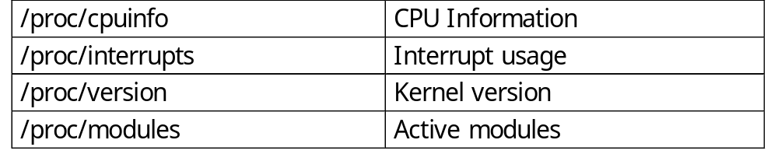
Special Files - /proc
Information about internal Linux processes are accessible to users via the /proc file system (in memory)
cat /proc/cpuinfo
vendor_id : IBM/S390
# processors : 1
bogomips per cpu: 86.83
processor 0: version = FF, identification = 045226, machine = 9672

Slide 64
File Systems
Linux supports many different types
Most commonly, ext2fs
  Filenames of 255 characters
  File sizes up to 2GB
  Theoretical limit 4TB
Derived from extfs
Highly reliable and high performer

Slide 65
File Systems
Other file systems:
  sysv - SCO/Xenix
  ufs - SunOS/BSD
  vfat - Win9x
  msdos - MS-DOS/Win
  umsdos - Linux/DOS
  ntfs - WinNT (r/o)
  hpfs - OS/2 (r/o)
Other File systems:
  iso9660 (CD-ROM)
  nfs - NFS
  coda - NFS-like
  ncp - Novell
  smb - LANManager etc

Slide 66
File Systems
mount
  Mounts a file system that lives on a device to the main file tree
  Start at Root file system
    Mount to root
    Mount to points currently mounted to root
  /etc/fstab used to establish boot time mounting

Slide 67
Virtual File System
VFS is designed to present a consistent view of data as stored on hardware
Almost all hardware devices are represented using a generic interface
VFS goes further, allowing the sysadmin to mount any of a set of logical file systems on any physical device

Slide 68
Virtual File System
Logical file systems promote compatibility with other operating system standards permitting developers to implement file systems with different policies
VFS abstracts details of physical device and logical file system allowing processes to access files using a common interface, without knowing what physical or logical system the file resides on

Slide 69
Virtual File System
Analogous to CMS:
  SFS
  Minidisks
Two different designs
Common/transparent access

Slide 70
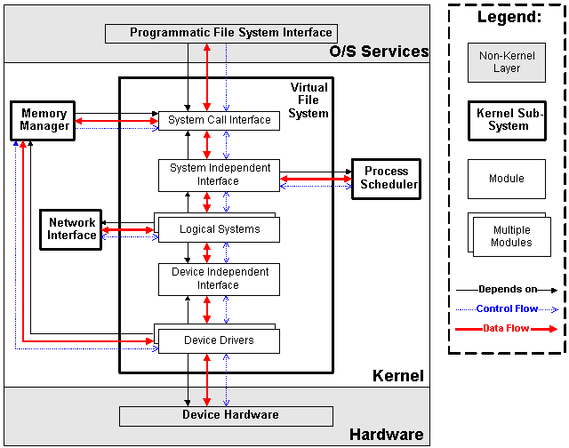

Slide 71
Processes
Processes are created in a hierarchical structure whose depth is limited only by the virtual memory available to the virtual machine
A process may control the execution of any of its descendants by suspending or resuming it, altering its relative priority, or even terminating it
Termination of a process by default causes termination of all its descendants; termination of the root process causes termination of the session
Linux assigns a process ID (PID) to the process

Slide 72
Processes
Foreground
  When a command is executed from the prompt and runs to completion at which time the prompt returns is said to run in the foreground
Background
  When a command is executed from the prompt with the token “&” at the end of the command line, the prompt immediately returns while the command continues is said to run in the background

Slide 73
Processes
Daemons
  Background processes for system administration are referred to as “daemons”
  These processes are usually started during the boot process
  The processes are not assigned any terminals
UID PID PPID C STIME TTY TIME CMD
root 5 1 0 1999 ? 00:00:14 [kswapd]
bin 254 1 0 1999 ? 00:00:00 [portmap]
root 307 1 0 1999 ? 00:00:23 syslogd -m 0
root 350 1 0 1999 ? 00:00:34 httpd

Slide 74
Processes
& causes process to be run in “background”
[root@penguinvm log]# sleep 10h &
[1] 6718
[root@penguinvm log]# ps -ef
UID PID PPID C STIME TTY TIME CMD
root 6718 6692 0 14:49 ttyp0 00:00:00 sleep 10h
Job Number
Process ID (ID)
Parent Process ID

Slide 75
Processes - UID & GID
Real UID
  At process creation, the real UID identifies the user who has created the process
Real GID
  At process creation, the real GID identifies the current connect group of the user for which the process was created

Slide 76
Processes - UID & GID
Effective UID
  The effective UID is used to determine owner access privileges of a process.
  Normally the same as the real UID. It is possible for a program to have a special flag set that, when this program is executed, changes the effective UID of the process to the UID of the owner of the program.
  A program with this special flag set is said to be a set-user-ID program (SUID). This feature provides additional permissions to users while the SUID program is being executed.

Slide 77
Processes - UID & GID
Effective GID
  Each process also has an effective group
  The effective GID is used to determine group access privileges of a process
  Normally the same as the real GID. A program can have a special flag set that, when this program is executed, changes the effective GID of the process to the GID of the owner of this program
  A program with this special flag set is said to be a set-group-ID program (SGID). Like the SUID feature, this provides additional permission to users while the set-group-ID program is being executed

Slide 78
Processes - Process Groups
Each process belongs to a process group
A process group is a collection of one or more processes
Each process group has a unique process group ID
It is possible to send a signal to every process in the group just by sending the signal to the process group leader
Each time the shell creates a process to run an application, the process is placed into a new process group
When an application spawns new processes, these are members of the same process group as the parent

Slide 79
Processes - PID
PID
  A process ID is a unique identifier assigned to a process while it runs
  Each time you run a process, it has a different PID (it takes a long time for a PID to be reused by the system)
  You can use the PID to track the status of a process with the ps command or the jobs command, or to end a process with the kill command

Slide 80
Processes - PGID
PGID
  Each process in a process group shares a process group ID (PGID), which is the same as the PID of the first process in the process group
  This ID is used for signaling-related processes
  If a command starts just one process, its PID and PGID are the same

Slide 81
Processes - PPID
PPID
  A process that creates a new process is called a parent process; the new process is called a child process
  The parent process (PPID) becomes associated with the new child process when it is created
  The PPID is not used for job control

Slide 82
Security Guidelines
Take Care With Passwords
  Use good ones (motherhood statement)
    Don't Use Real Words
    Make Sure They Are Not Easily Guessed
    Use Combinations Of Upper and Lower Case, Numbers, Punctuation
    One Method: Take first letter of a sentence or book title, insert numbers and punctuation.

Slide 83
Security Guidelines
Take care of passwords (continued)
  Use Shadow Passwords
    Allows encrypted passwords to be in a file that is not world readable
  Use Password Aging
    Requires shadow passwords

Slide 84
Security Guidelines
Restrict Superuser Access
  Restrict where root can log in from
    /etc/securetty restricts root access to devices listed
  Use wheel group to restrict who can su to root
    Put users who can su to root in wheel group in /etc/group file.

Slide 85
Security Guidelines
Use groups to allow access to files that must be shared
  Otherwise users will set world permission
Be careful with SUID and SGID
  Avoid setting executables to SUID root
  Wrap SUID root wrapper around programs if they must be run SUID root
  Create special accounts for programs that must run with higher permissions

Slide 86
Security - Important Files
/etc/passwd - password file
/etc/shpasswd - shadow password file
/etc/group -lists groups and users contained in groups
/etc/services - lists network services and their ports
/etc/ftpusers - contains list of accounts that cannot use ftp
/etc/hosts.equiv - generic list of remote users
~/.rhosts - list of remote users for a specific account
/etc/hosts - host definition list
/etc/hosts.lpd - hosts who can use remote printing
/etc/hosts.allow - lists services that remote users are allowed to use
/etc/hosts.deny - lists services tthat remote users are not allowed to use
/etc/nologin - no login message that also disables logins
/etc/securetty - lists legal terminals for root to login from
/etc/exports - lists locations that can be remotely accessed via NFS
/etc/syslog.conf - configures the syslog facility
/etc/inetd.conf - configures inetd

Slide 87
Linux/390 Specifics
An ASCII implementation
Adds a layer of abstraction to I/O
  Channel based v IRQ based
Support for ECKD using SSCH
Support for VM minidisks (ECKD, CKD, FBA, VDISK)

Slide 88
Linux/390 Specifics
Runs natively, in LPAR, or under VM/ESA
Uses relative instructions: G2, P/390, R/390 or better
Will use hardware IEEE FP or will emulate
Network drivers for CTCA/ESCON, OSA-2, and IUCV (VM only)
3215 emulation for virtual console
Hardware console driver (HMC)

Slide 89
Linux/390 Specifics
GNU tools ported
  C/C++ compiler (gcc-2.95.1)
  Assembler and linker (binutils-2.9.1)
Packages “ported”:
  Regina; THE; UFT; X11; OpenLDAP; IMAP; Sendmail; Bind; RPM; Samba 2.0.6; Apache; Perl

Slide 90
Linux in the Business World
Issues and observations

Slide 91
Linux’s place in the market
The business world is interested in:
  Efficiency and effectiveness
  Networked economy
  Network-based businesses

Slide 92
Linux’s place in the market
The world is heterogeneous
  90% of Fortune 1000 companies use 3 or more Operating Systems
The demands of e-business
  Integrates with existing investments
  Supports any client
  Applications built/deployed independent of client
  24 x 7

Slide 93
Linux’s place in the market
Importance of the application model
  Server-centric and based on standards that span multiple platforms
  Leverage core business systems and scale to meet unpredictable demands
  Quick to deploy, easy to use and manage

Slide 94
Linux’s place in the market
ISVs which have made Linux announcements:
  BEA; Novell; SAP; Informix; Oracle, IBM; HP; CA; ApplixWare; Star; Corel; Cygnus; MetroWerks; ObjectShare; Inprise
Media spotlight:
  CNN; PCWorld; PCWeek; InternetWeek

Slide 95
Linux’s place in the market
Early commercial users
  Cendant Corporation - 4000 hotels
  Burlington Coat Factory - back office functions
  Northwest Airlines - 23 flight simulators
Intel announcement January 5 2000
  New web appliances to run Linux
  At the insistence of customers (e.g. NEC)

Slide 96
Linux’s place in the market
Impacts:
  Applications:
    Webservers (65%)
    WebInfrastructure (mail, DNS) (15%)
    File/Print (15%)
    DB & DB Applications (2%)
  Observations
    Linux/Apache share of Web serving high
    Autonomous departments
    Many SMB and small ISP
    CIOs discovering they have Linux running somewhere
    Strong mindshare among developers

Slide 97
Linux’s place in the market
Linux’s appeal
  Embraces new generation of web-based apps
  Player in the heterogeneous e-business world
  Provides flexibility and choice of environment
  Open Source focuses on open standards

Slide 98
Linux’s place in the market
Challenges for growth
  Products/Technologies/Offerings
    Support services
    ISV applications
    Service providers
  Trends
    Movement to mainstream
    Standards
    Ease of use

Slide 99
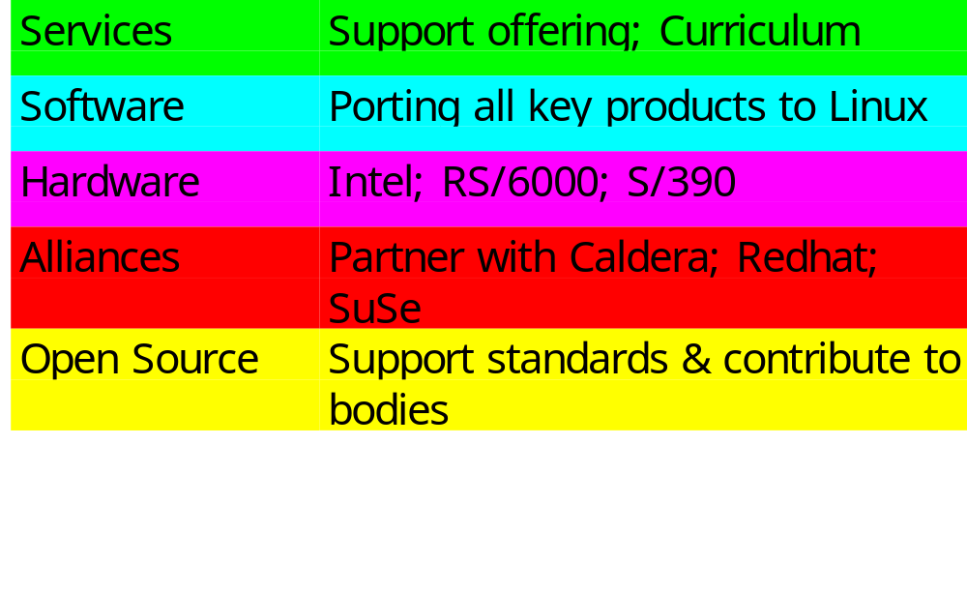
IBM’s focus on Linux

Slide 100
IBM Software Announcements
DB2 Universal Database
Transarc AFS (distributed file system)
On Demand Server
Lotus Domino R5
WebSphere
Tivoli

Slide 101
Linux’s place in the market
Summary
  Linux is viable in many key application areas
  Linux has moved from small technical projects to significant deployment
  IBM claims to be fully supportive of Linux
    Part of their heterogeneous strategy
    Open source supporter
    Hardware, software, and service offerings

Slide 102
Linux
Available Commercial Software

Slide 103
Website Development
ASWedit, HTML editor
Empress DataWEB
EZ-EDIT
LinkScan
TalentSoft Web+ (WebPlus)
VirtuFlex 1.1
Visual prolog
Web Crossing
ThreadTrack WebTailor from Webthreads.

Slide 104
Databases
c-tree Plus
Empress
Essentia
FairCom Server
INFORMIX-SE
Just Logic/SQL
KE Texpress
Qddb
Raima Database Manager++
Empress Embedded RDBMS
SOLID Server
Velocis Database Server
Yard SQL

Slide 105
Data Visualization and CAD
IDL (Interactive Data Language)
Megahedron
Tecplot 7.0
VariCAD
VARKON
XVScan

Slide 106
Development Tools
ACUCOBOL-GT
Amzi! Prolog & Logic Server
Basmark QuickBASIC
Critical Mass CM3
Dynace
Absoft Fortran 77
Finesse
ISE Eiffel
EiffelBench
C-Forge IDE
IdeaFix
j-tree
KAI C++
Khoros Pro 2.1

Slide 107
Development Tools
MetaCard
ObjectManual Rel 3.0
Critical Mass Reactor
Resource Standard Metrics
r-tree
sdoc (Source Documenter)
SEDIT, S/REXX
SNiFF+
ST/X (Smalltalk/X)
tdb (Tcl Debugger)
tprof (Tcl Profiler)
View Designer/X (VDX)
XBasic
XMove 4.0 for Linux

Slide 108
Emulation Tools
Emulus
Executor 2
Wabi 2.2 for OpenLinux

Slide 109
Financial Software
BB Stock Pro and BB Stock Tool
TimeClock

Slide 110
Libraries
FontScope
INTERACTER
Matrix<LIB> - C++ Math Matrix Library
PKWARE Data Compression Library for Linux
readyBase
SIMLIB IG

Slide 111
Mathematics
Maple V Release 4 - The Power Edition
MATCOM and MATCOM MATH LIBRARY
Mathematica 3.0
MATLAB and Simulink

Slide 112
Multimedia
Peter Lipa and his Journeys
Lucka Vondrackova and her Journeys
MpegTV Player 1.0
Peter Nagy and his Journeys
Xaudio

Slide 113
Network Servers
Critical Angle X.500 Enabler
DNEWS News Server
Aventail Internet Policy Manager
Aventail VPN
WANPIPE
Zeus Web Server

Slide 114
Office Tools
Corel WordPerfect 8
The American Heritage Dictionary Deluxe
Applixware Office Suite
D.M.S. Document Management System
HotWire EasyFAX
NExS, the Network Extensible Spreadsheet
Axene Office
Projector and Projector/Net
The Virtual Office System
Axene XAllWrite
Axene Xclamation
Axene XQuad

Slide 115
Text Processing
Edith Pro for X11
TeraSpell 97 for Emacs

Slide 116
System Administration
Host Factory
PerfectBACKUP+
Venus

Slide 117
X Windows Related
Accelerated-X Display Server
BXwidgets
BXwidgets/DB
Laptop, Accelerated-X Display Server
MaXimum cde Developer's Edition v1.0
Multi-headed, Accelerated-X Display Server
OpenGL, Accelerated-X Display Server
OSF-Certified Motif

Slide 118
Other Software
ABACUS 4
BBBS
Clustor
FootPrints
Aladdin Ghostscript
Magician
journyx WebTime
LanSafe
LjetMgr
Synchronize/CyberScheduler

Slide 119
Additional Resources
UNIX Systems Administrator Resources
  http://www.ugu.com/
Linux/390 Observations and Notes
  http://penguinvm.princeton.edu
Introduction to Linux
Introduction to UNIX
Linux/390 Installation
Linux Administration Made Easy
  http://www.linuxninja.com/linux-admin/book1.html
Conceptual software architecture of the Linux kernel

Slide 120
Additional Resources
http://www.linux.org
http://www.tux.org
http://www.li.org

